Slide 1

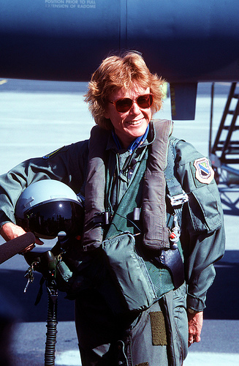

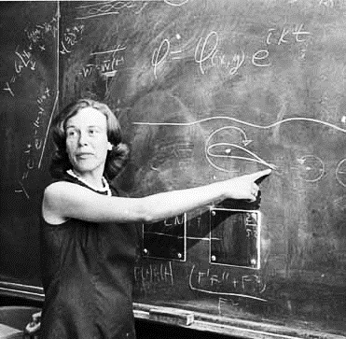
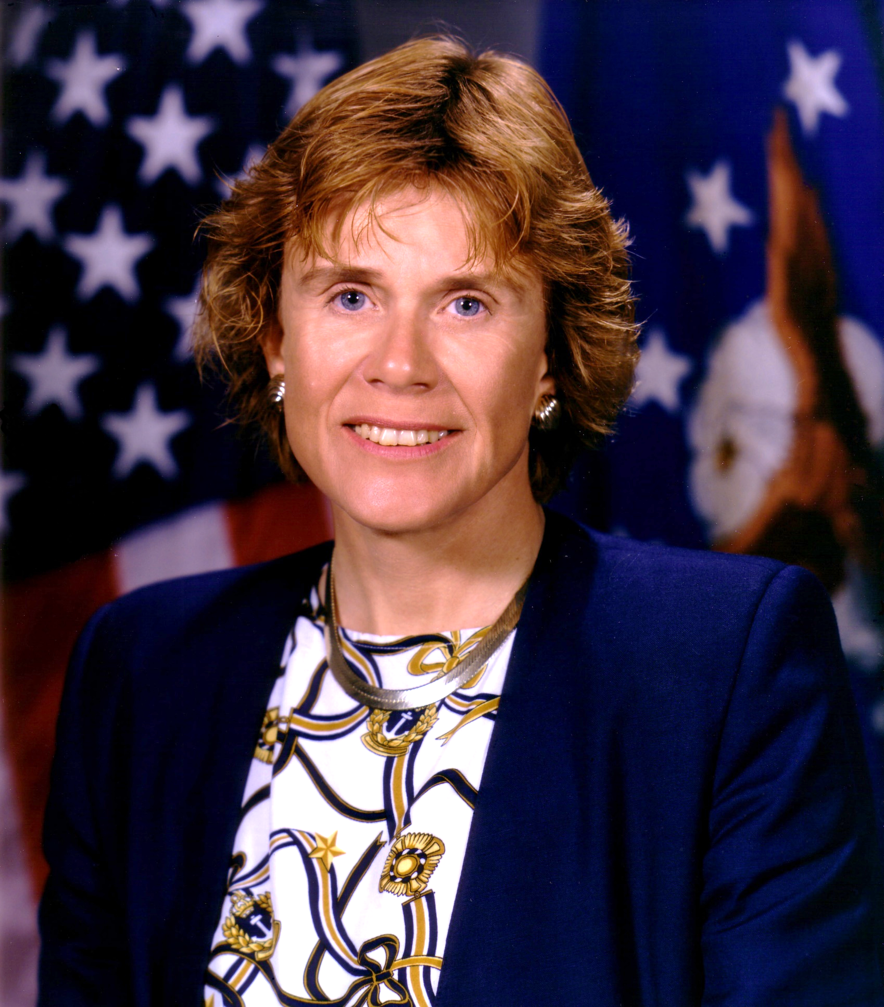
Women
Sheila
Widnall SecAF #18
To change pictures:
Save the picture of the person you wish to use.
Single-left-click the grouped picture/shapes you wish to change on the poster. Single-left-click again on the picture.
Now single-right-click the picture and select “Change Picture” from the menu.
Choose the picture file you saved.
You may wish to single-left-click the grouped picture/shapes and single-left-click the new picture again to adjust its size or crop it—especially useful if the new picture is not the same aspect ratio as the previous one.
DO NOT CHANGE ROSIE THE RIVETER PICTURE!!!
In Technology
1960-1993 Student, Professor, and Assoc. Provost at MIT
1993 Became the first female Secretary of the Air Force
2003 Served on Columbia Space Shuttle disaster board of investigation
In 1956, she was one of only 23 women in her freshman class at MIT. After graduating with her Bachelor’s, Master’s, and Ph.D., she became a professor and eventually led the institute as its Associate Provost. Dr. Widnall has been described as a “Rock Star,” a “Trailblazer,” and an “Inspiration.”
From Dr. Widnall’s famous Digits of Pi speech: “We all have unconscious attitudes that impact our effective-ness… when I was a young professor, I walked in to give the first lecture and was met by two new students. One knew who I was. The other thought I was the professor’s secretary and was impressed I was able to give the lecture. I did in fact eventually become a Secretary—but that is another story…”
What paths will you trailblaze that no one has traveled before?

